Slide 1
Insurance Customer Response Prediction

Slide 2
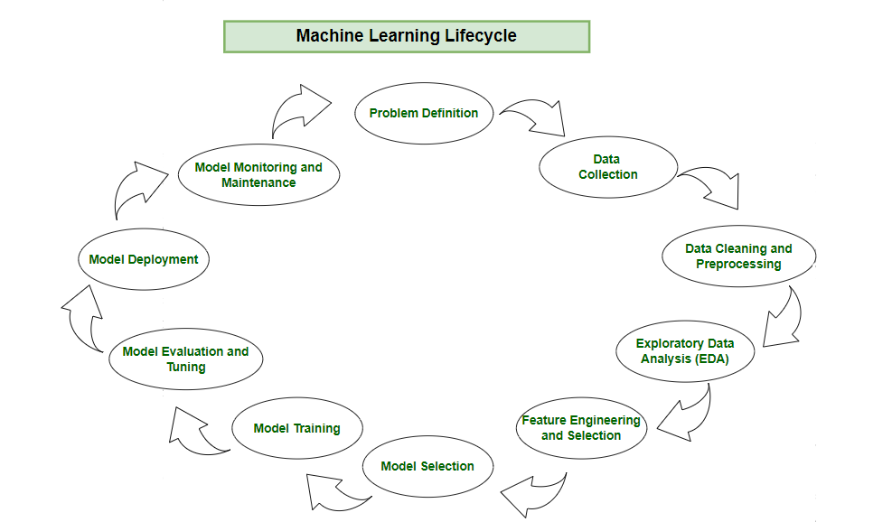
Agenda
Introduction
Data Collection
Exploratory Data Analysis (EDA) And Visualization
Data Preprocessing
Machine Learning Model Development
Model Deployment

Slide 3
Introduction
Brief Overview of the Session:
This session is an immersive journey into an end-to-end data science project.
We will explore the entire data science workflow from data collection to model deployment.
Importance of End-to-End Data Science:
Understanding the complete data science process is essential for real-world applications.
It mimics the way data science projects are conducted in industry, from raw data to actionable insights.

Slide 4
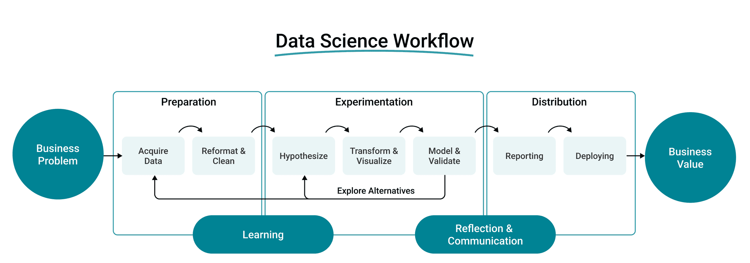
Goal: Turn business problems into actionable solutions for value creation.
→ Data Science Workflow:
Preparation: Collect and clean data.
Experimentation: Analyze, model, and validate.
Distribution: Report insights and deploy solutions.

Slide 5

Insurance Customer Response Prediction
In the rapidly evolving insurance industry, understanding and predicting customer behavior is key to staying competitive and maximizing policy sales. This project focuses on leveraging machine learning techniques to accurately predict customer responses to insurance policy offers. By analyzing customer characteristics and policy details, the model aims to provide actionable insights for targeted marketing strategies, efficient resource allocation, and personalized offerings.
Through this initiative, the project seeks to enhance the sales process by optimizing sales channels and improving conversion rates. By combining data exploration, advanced analytics, and visualization techniques, the project delivers a robust machine learning solution that aids decision-making and streamlines the customer acquisition process in the insurance sector.

Slide 6
Objective for the Project:
The objective of this project is to develop a machine learning model that accurately predicts customer responses to insurance policy offers. This will enable:
Enhanced Targeted Marketing: Identify key factors influencing customer decisions and tailor marketing strategies effectively.
Optimized Sales Channels: Analyze customer behavior to improve resource allocation across sales channels.
Increased Efficiency: Facilitate personalized policy offers, resulting in higher conversion rates and better customer engagement.
Data-Driven Decision Making: Leverage insights from customer and policy data to streamline the insurance sales process.

Slide 7

Data Collection
Data collection in data science is the process of gathering data from various sources. It involves identifying sources, gathering data, and storing it in a structured format.
Clean, high-quality data is essential for accurate analysis and modeling.

Slide 8

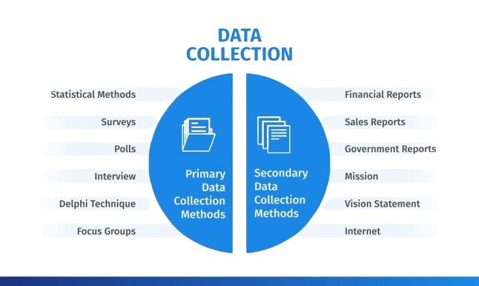
Data Collection

Slide 9

Data Collection
Dataset: Insurance Customer Response Prediction(data.cvs)
Sources:
Customer demographics (age, income, location).
Policy details (type, premium, tenure).
Historical responses (purchase/decline).
Attributes:
Customer: Gender, age, occupation.
Policy: Type, premium, tenure.
Response: Past interactions, outcomes.
Methods:
CRM systems, databases, surveys.
Quality:
Ensure accuracy, completeness, and handle missing values.

Slide 10
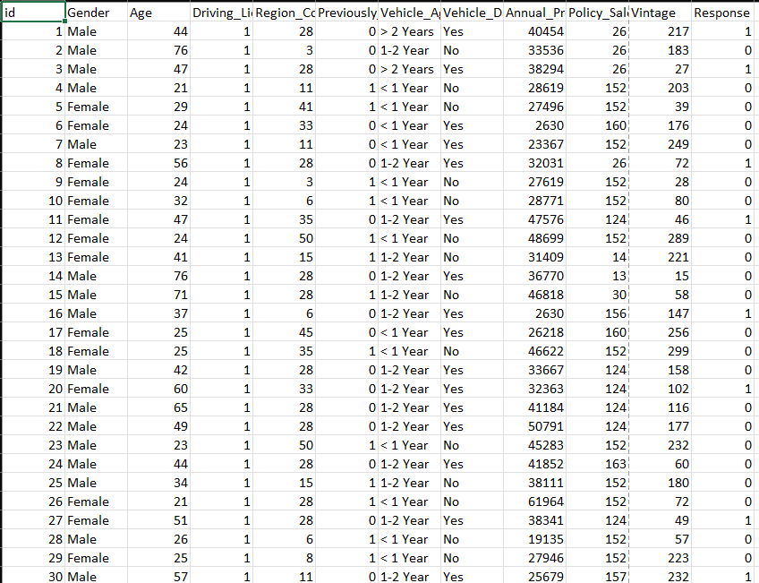
Data Collection

Slide 11

Data Preprocessing
Handling Missing Values
Discuss strategies for addressing missing data, such as imputation or removal.
Dealing with Outliers
Identify and address outliers that can impact model performance.
Encoding Categorical Variables
Explain techniques to convert categorical data into a format suitable for machine learning models.
Splitting Data into Training and Testing Sets
Emphasize the importance of dividing data for model training and evaluation.

Slide 12

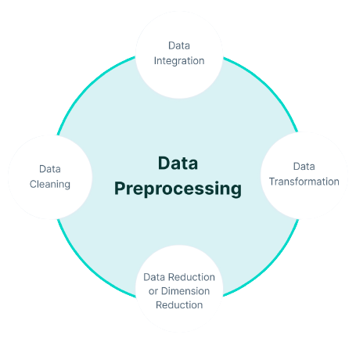
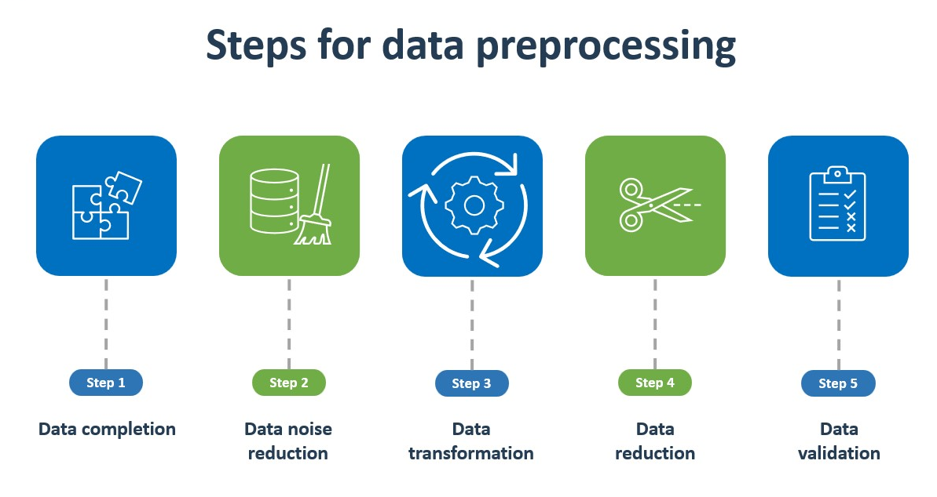
Data Preprocessing

Slide 13
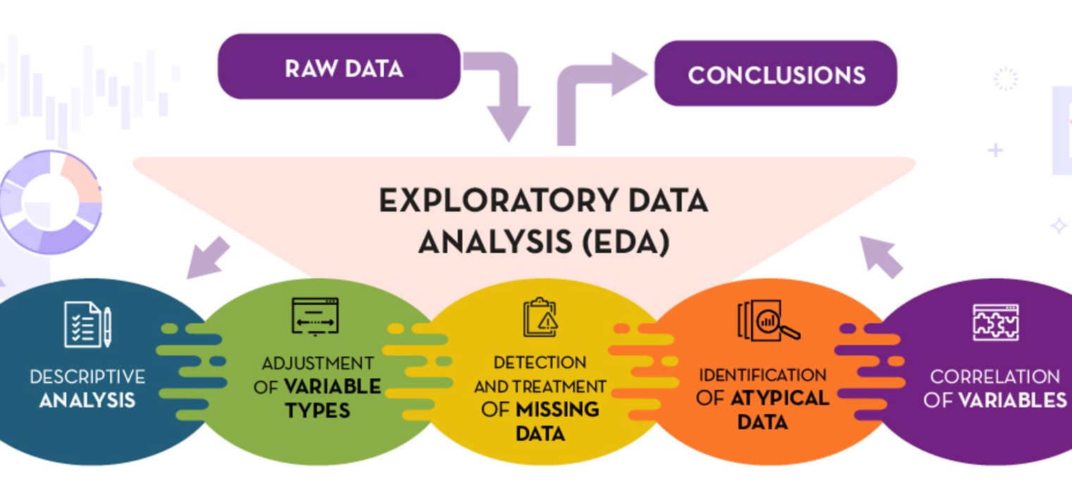
Exploratory Data Analysis (EDA)

Slide 14
Exploratory Data Analysis (EDA)
EDA - Data Visualization:
Types of Visualizations: Use histograms, scatter plots, etc., to understand data patterns.
Live Demonstration: Show how to create visualizations with Python (Pandas, Matplotlib, Seaborn).
Interpreting Visualizations: Learn to extract insights from visual data.

Slide 15
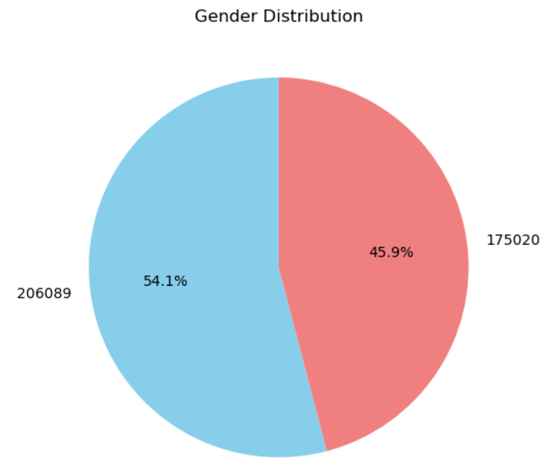
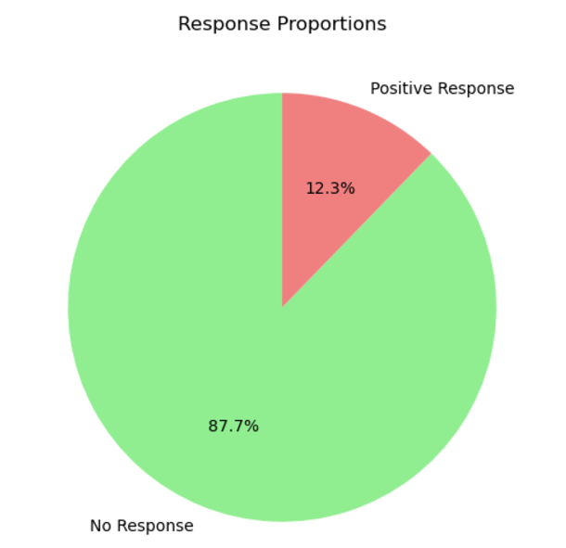
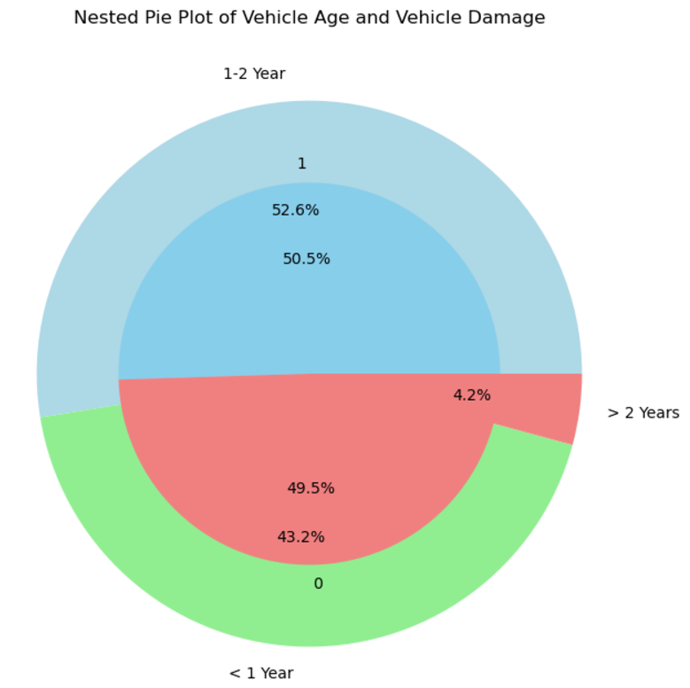
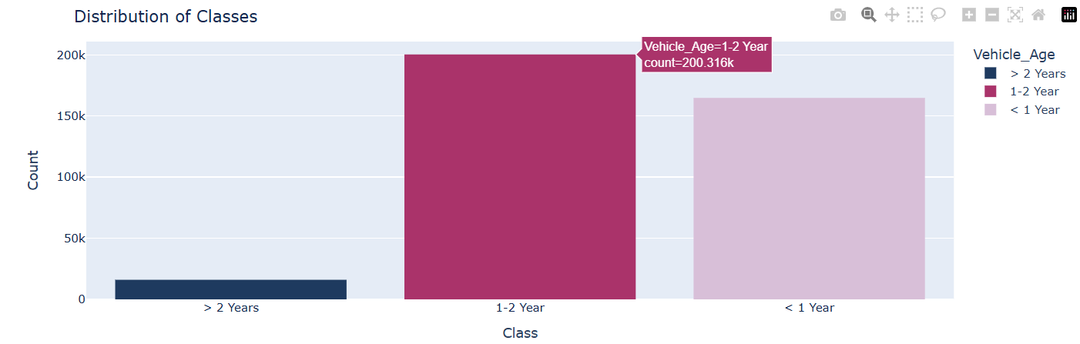
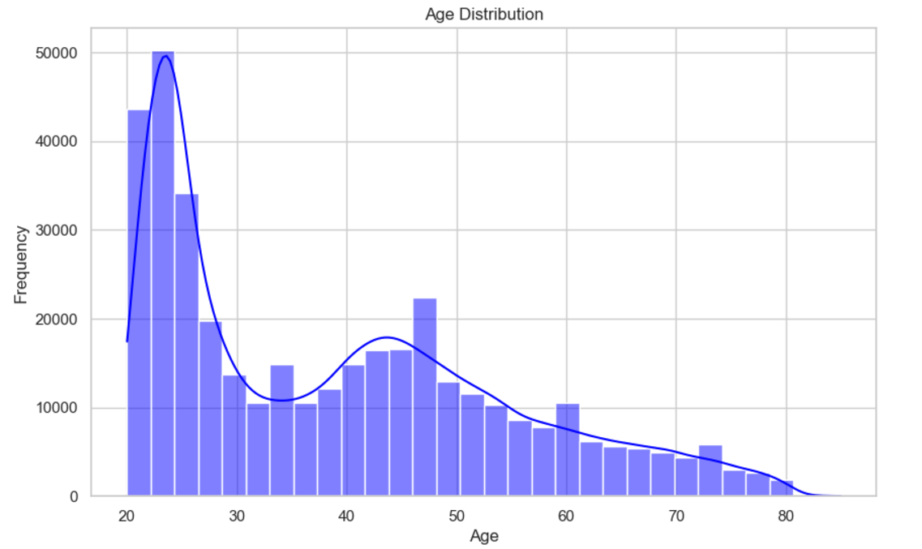
Exploratory Data Analysis (EDA)

Slide 16
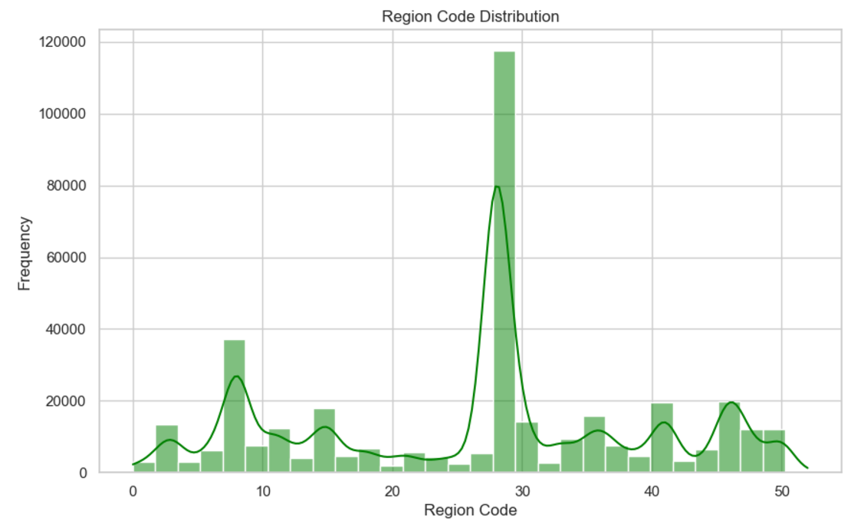
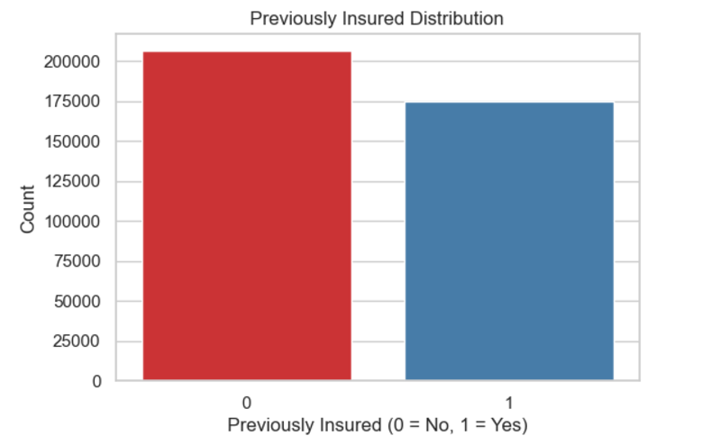
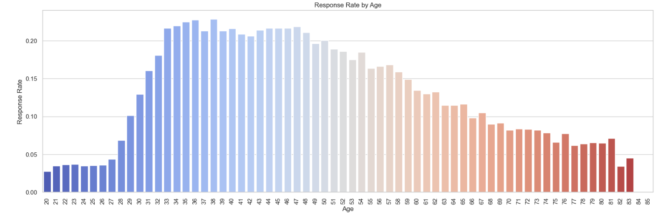
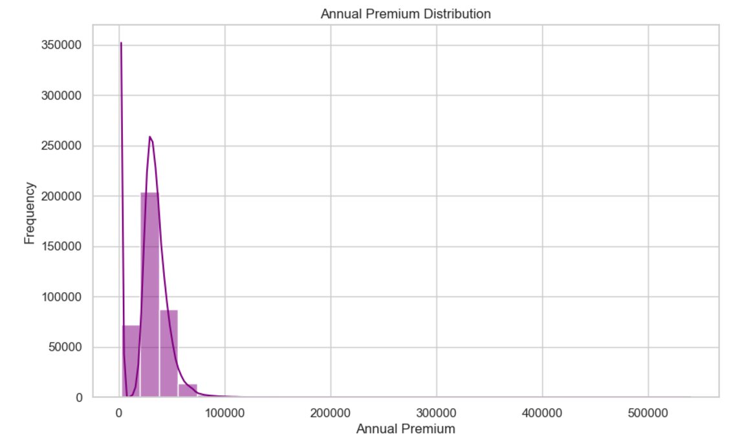

Slide 17
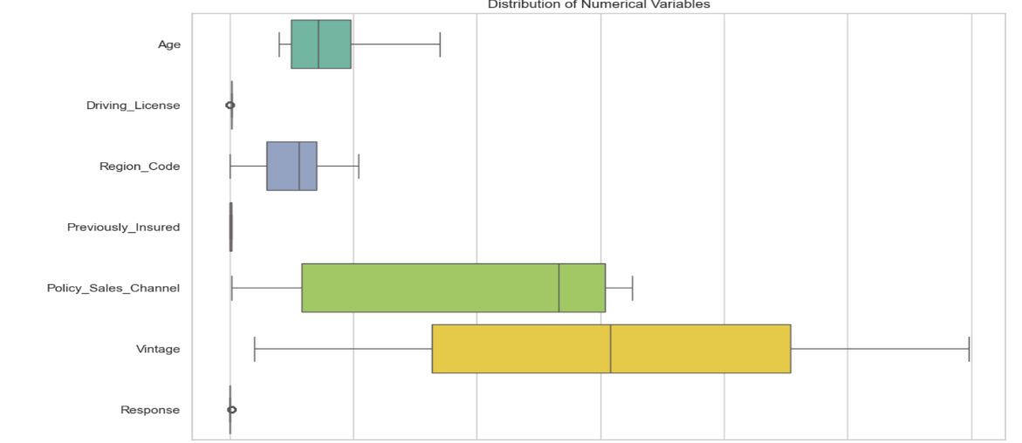
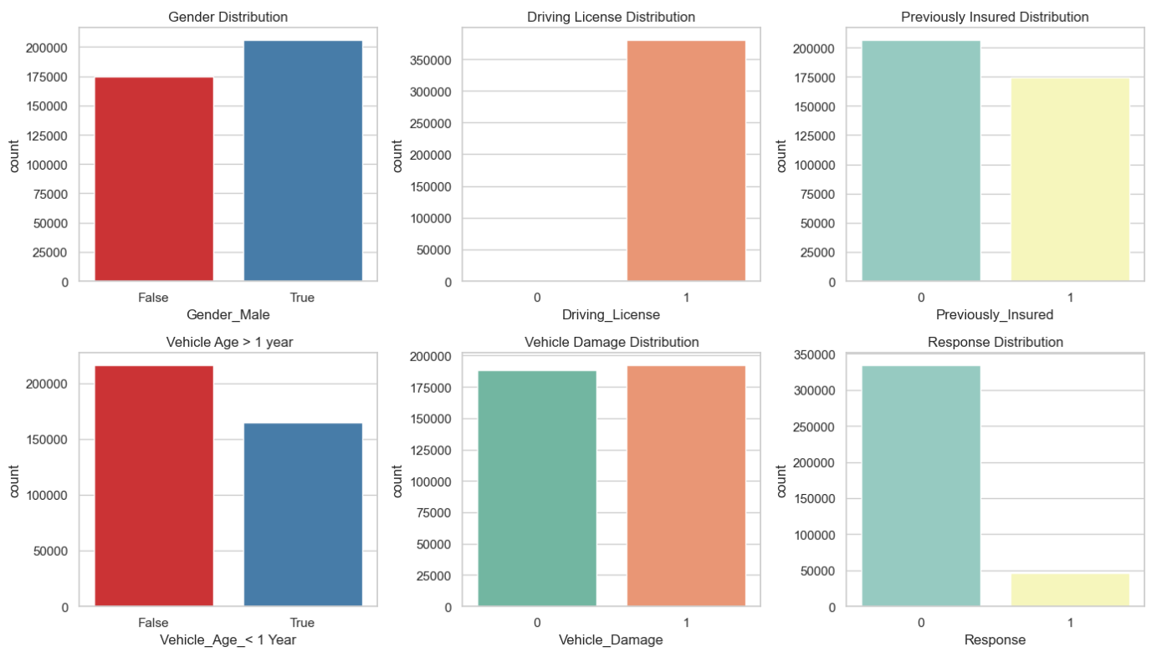
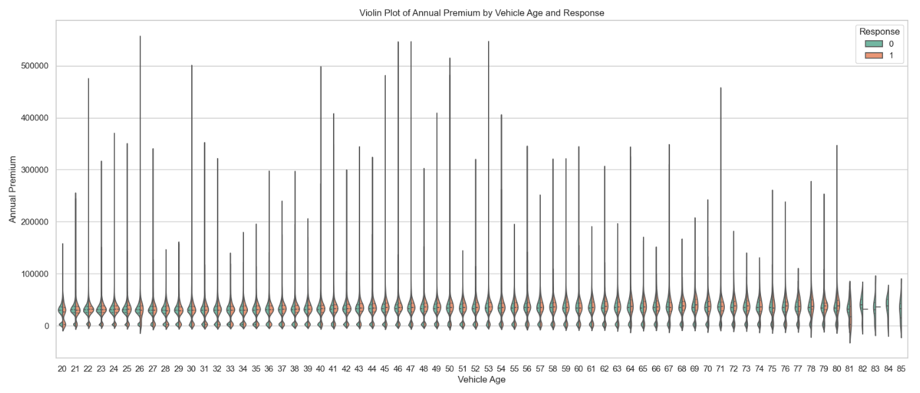

Slide 18
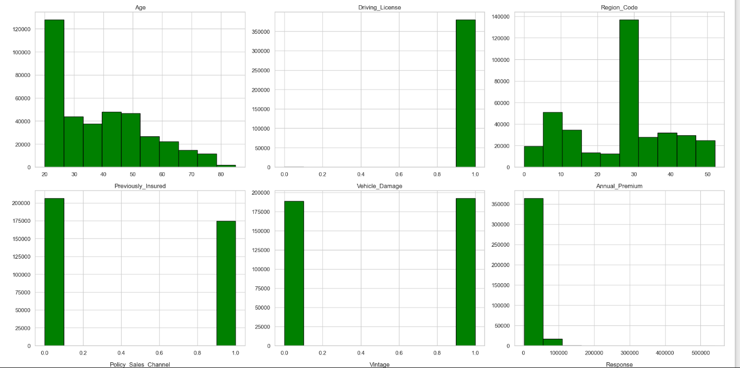
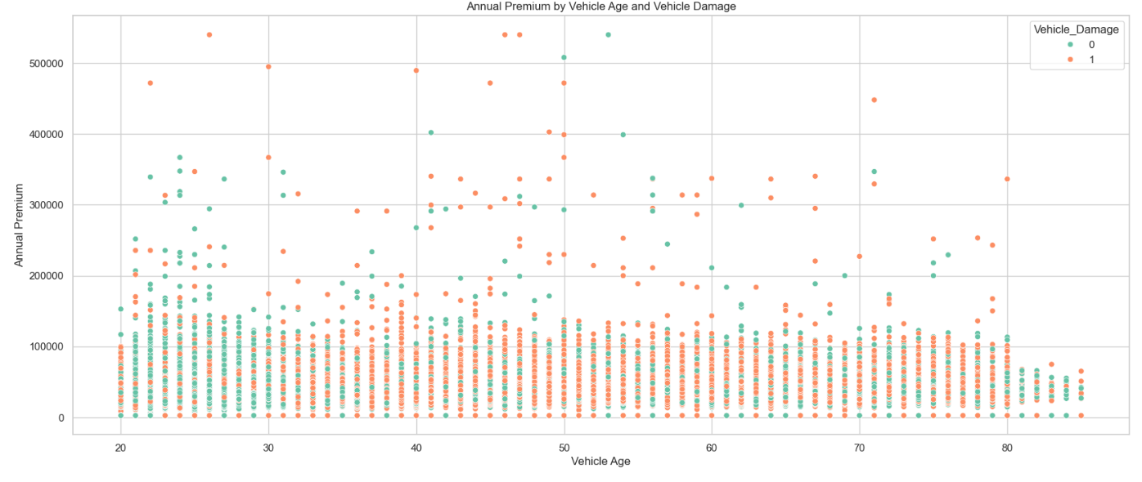
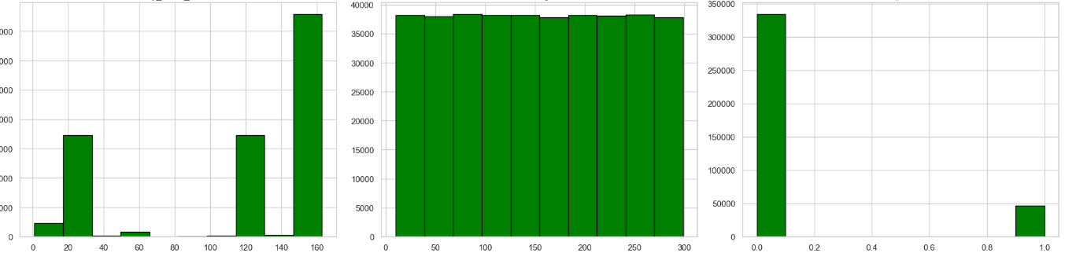
Title
Content

Slide 19
Machine Learning Model Development
Choosing a Machine Learning Algorithm: Select the right algorithm (e.g., Logistic Regression, Random Forest, SVM, Ada boost, XG Boost) for your problem.
Training and Evaluating the Model: Cover the process of training and evaluating the model to ensure its robust and reliable.
Hyperparameter Tuning: Optimize model parameters for improved performance.
Model Evaluation Metrics: Use metrics like accuracy, precision, and recall to assess how well the model is performing.

Slide 20
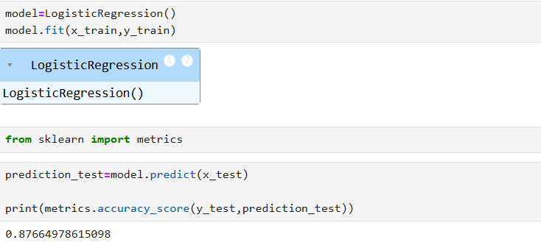
Machine Learning Model Development
Supervised Learning:
Logistic Regression:
Type: Supervised learning algorithm used for classification tasks.
Concept: It models the relationship between the dependent binary variable (target) and one or more independent variables by estimating probabilities using a logistic function. It's suitable for binary classification.

Slide 21
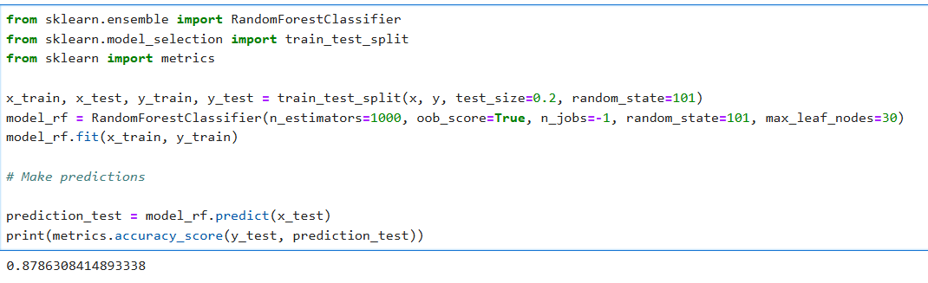
Machine Learning Model Development
2. Random Forest:
Type: Ensemble learning method, specifically a bagging algorithm.
Concept: It builds multiple decision trees and combines their predictions to produce a more accurate and robust result. Each tree in the forest is trained on a random subset of the data.

Slide 22
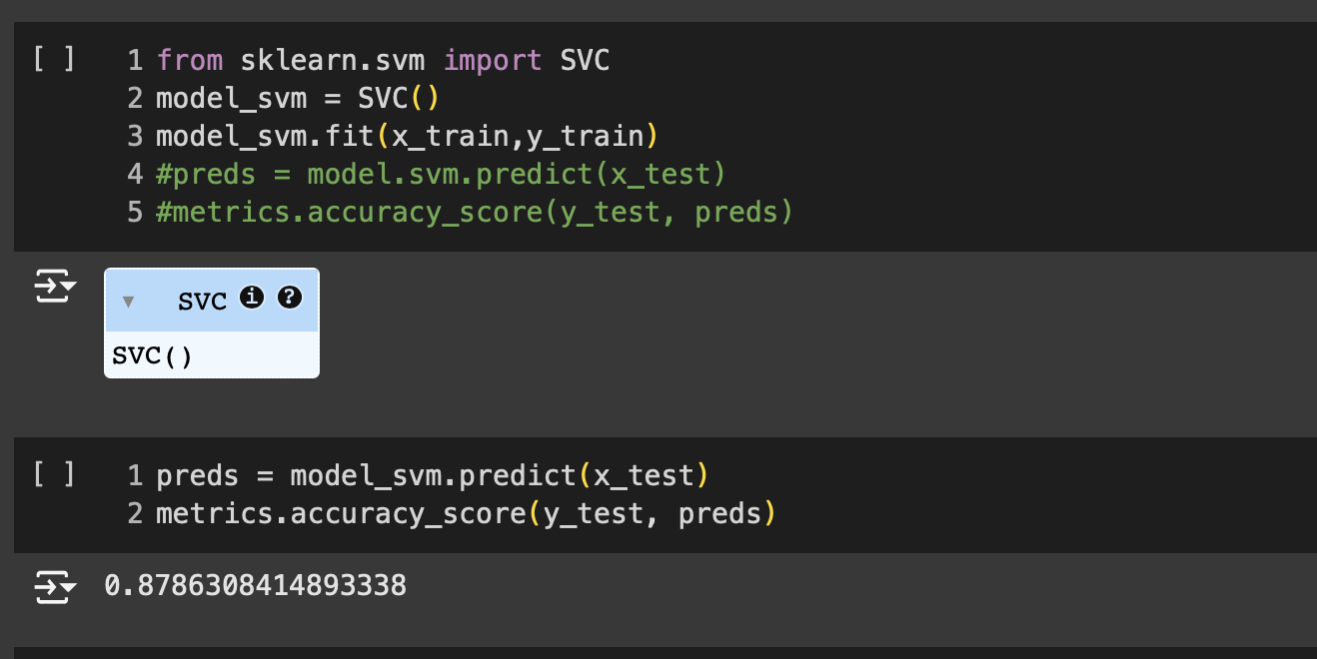
Machine Learning Model Development
3. Support Vector Machine (SVM):
Type: Supervised learning algorithm used for classification and regression tasks.
Concept: SVM finds a hyperplane that best separates data points of different classes. It aims to maximize the margin between the classes while allowing for a small number of misclassifications.

Slide 23
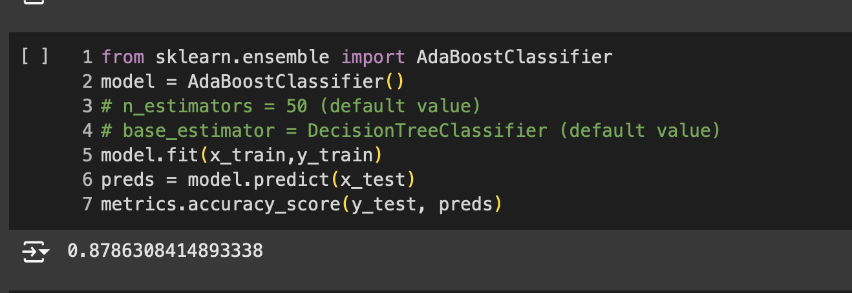
Machine Learning Model Development
4. Ada Boost:
Type: Ensemble learning method, specifically a boosting algorithm.
Concept: Adaboost combines multiple weak classifiers to create a strong classifier. It assigns weights to data points, giving more importance to misclassified points, and iteratively improves the model.

Slide 24
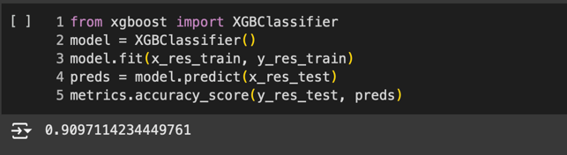
Machine Learning Model Development
5. XG Boost (Extreme Gradient Boosting):
Type: Ensemble learning method, specifically a boosting algorithm.
Concept: XG Boost is an advanced gradient boosting algorithm known for its efficiency and performance. It builds decision trees sequentially, focusing on minimizing the loss function. It uses gradient descent for optimization.

Slide 25
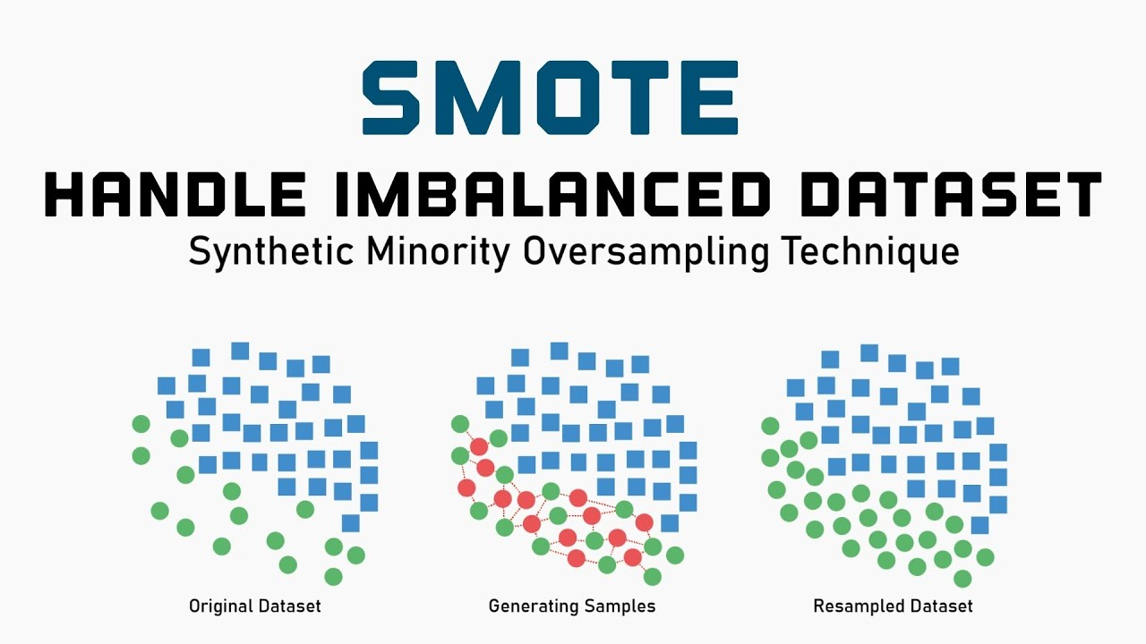
Machine Learning Model Development
SMOTE Library
- The SMOTE (Synthetic Minority Over-sampling Technique) library is used for oversampling imbalanced datasets by generating synthetic examples for the minority class.
- This helps to balance the dataset and improve the performance of machine learning models.

Slide 26
Machine Learning Model Development
Model Performance:
Logistic Regression: Accuracy – 87.92%
Random Forest: Accuracy – 87.96%
Support Vector Machine (SVM): Accuracy – 87.96%
ADA Boost: Accuracy – 87.96%
XG Boost: Accuracy – 91.11%(By using SMOTE)
Interpretation
XG Boost high accuracy is due to advanced features like handling imbalanced data with SMOTE, managing large datasets with optimized algorithms, and reducing overfitting using regularization. It captures important features, ranks them well, and uses fast parallel computing for efficient training, making it ideal for customer response prediction

Slide 27
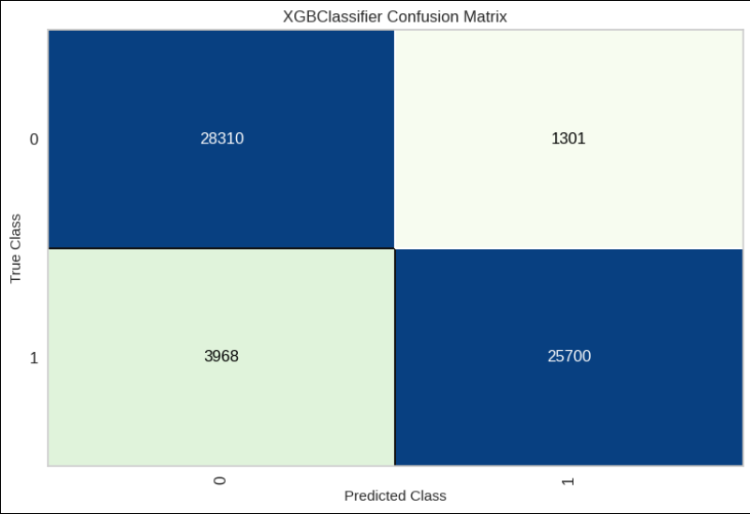
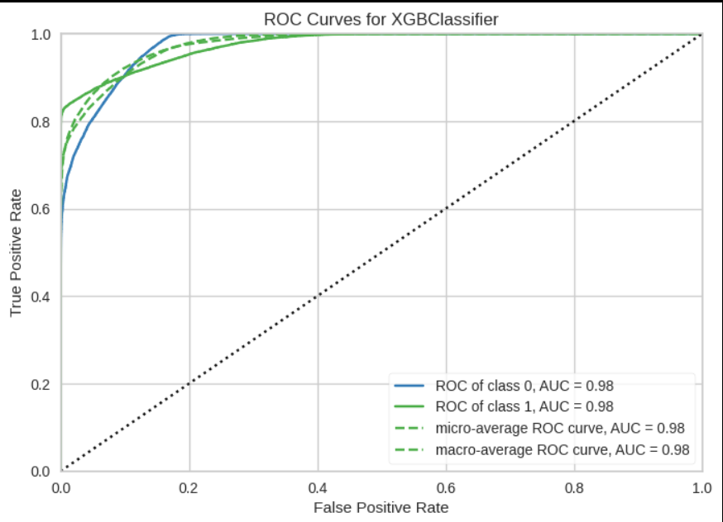
XGB Classifier Confusion Matrix ROC Curves For XGB Classifier

Slide 28

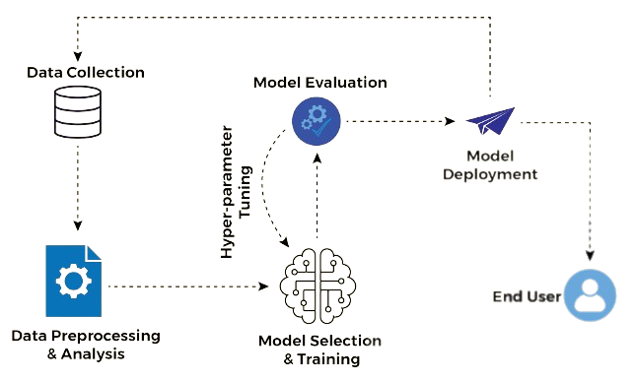
Introduction to Model Deployment
Model deployment is the process of making a trained machine learning model available for use in real-world applications.
It involves taking a model from the development and testing phase and integrating it into a production environment.

Slide 29

Introduction to Model Deployment
Challenges in Model Deployment:
Scalability: Deploying a model that can handle a large number of requests efficiently can be challenging.
Data Drift: Real-world data often changes over time, and deployed models need mechanisms to adapt to this data drift.
Security: Ensuring that the deployed model is secure and not vulnerable to attacks or misuse is critical.
Monitoring and Maintenance: Continuous monitoring and maintenance are required to keep deployed models performing at their best.

Slide 30
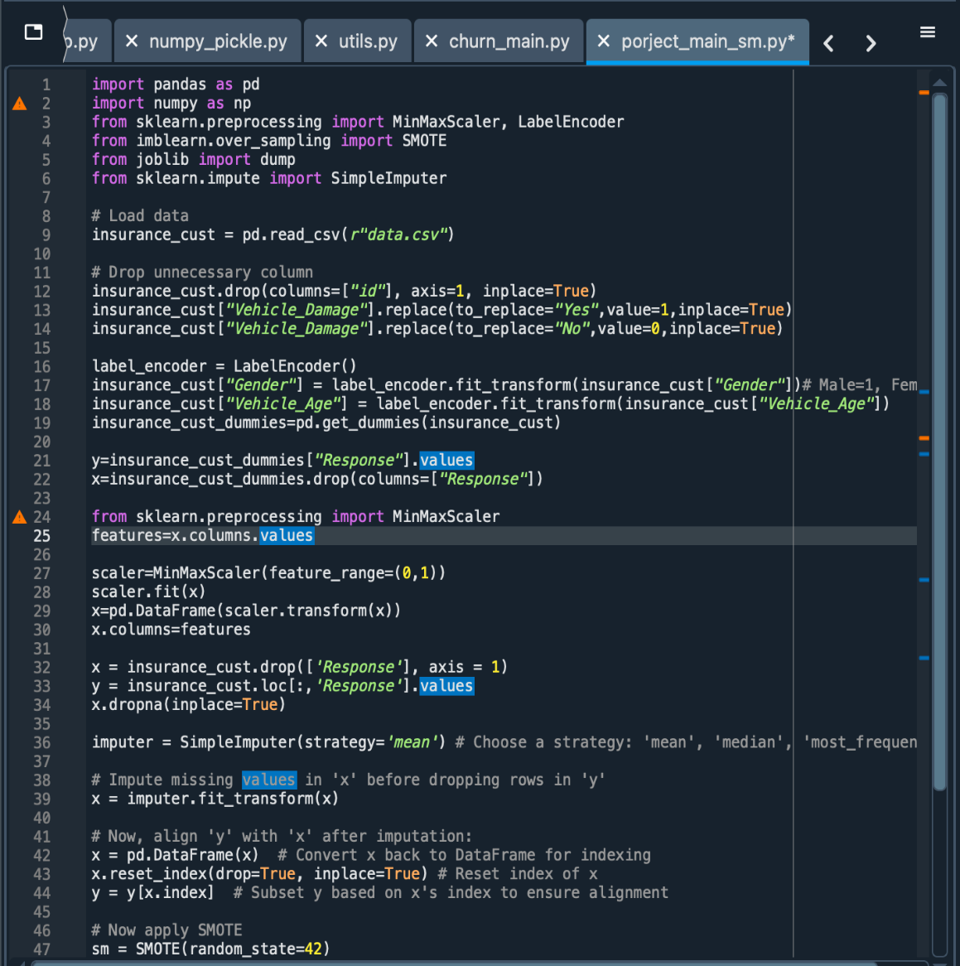
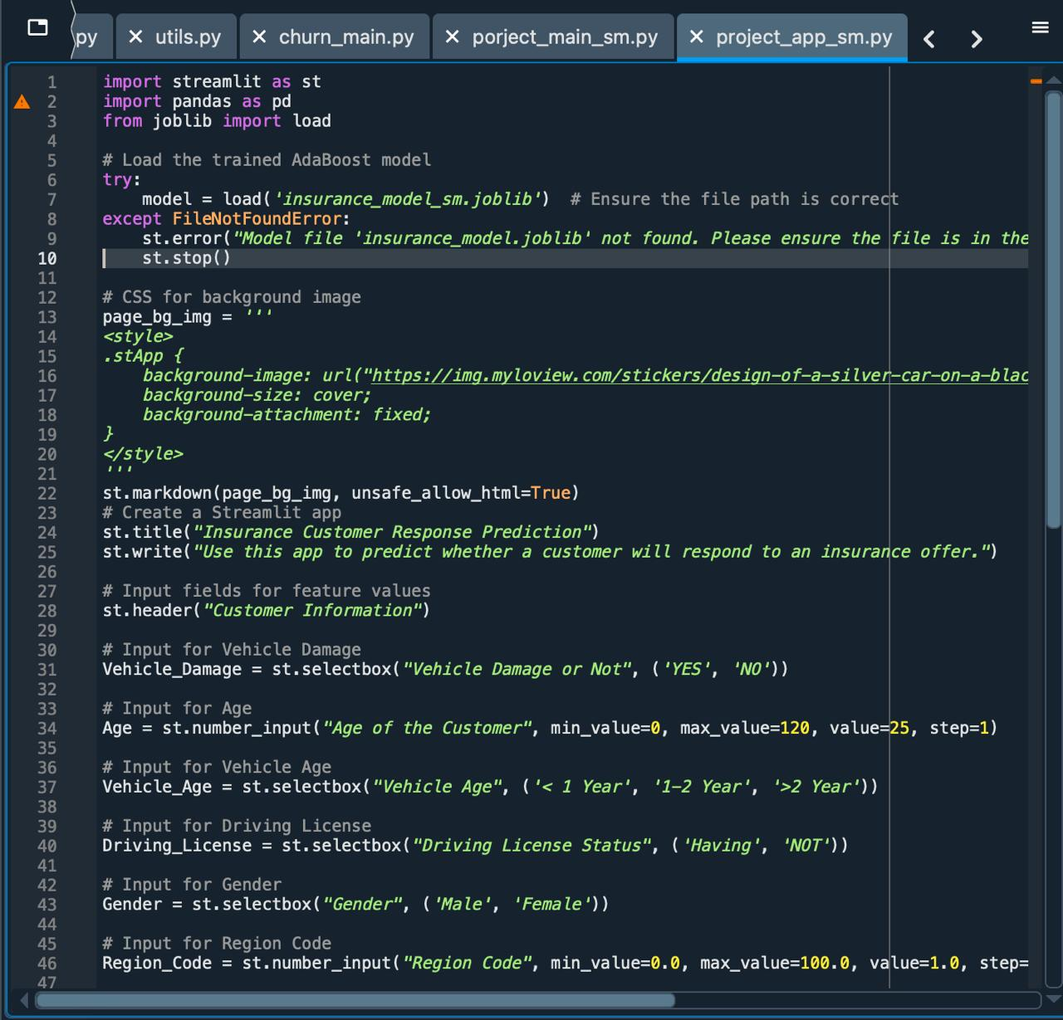
Model Deployment
Insurance Customer Response ML Model file – porject_main_sm
Streamlit Web App file – project_app_sm

Slide 31

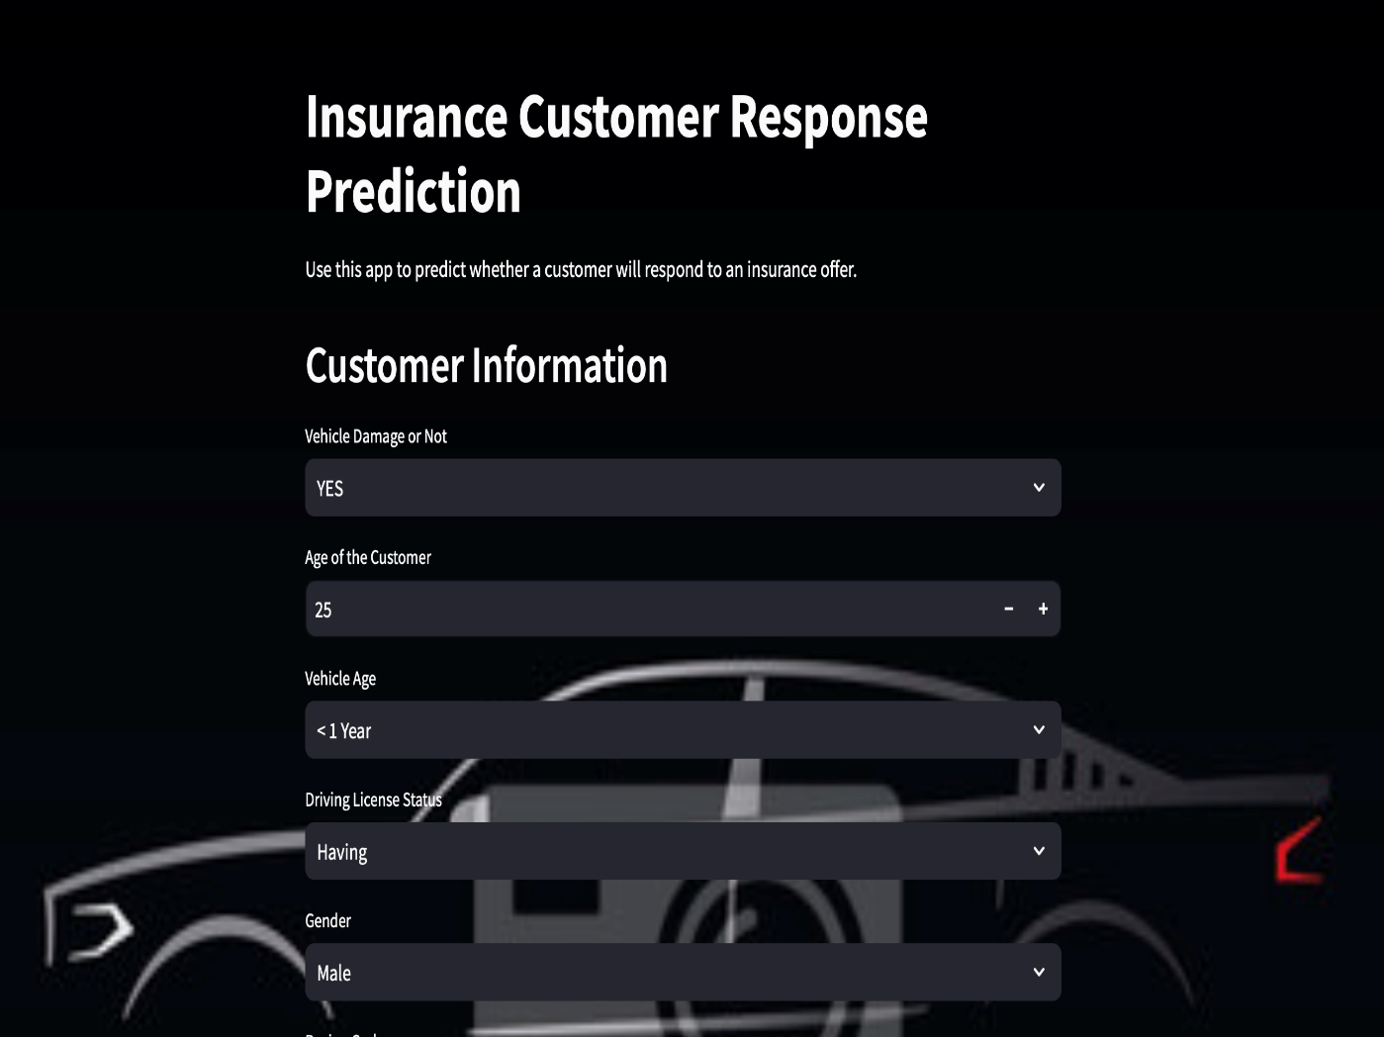
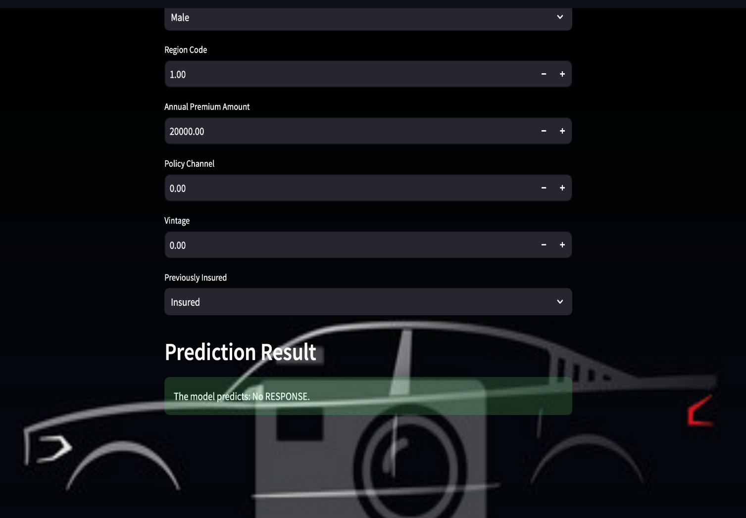
Streamlit web app for Insurance Customer Response Prediction App

Slide 32
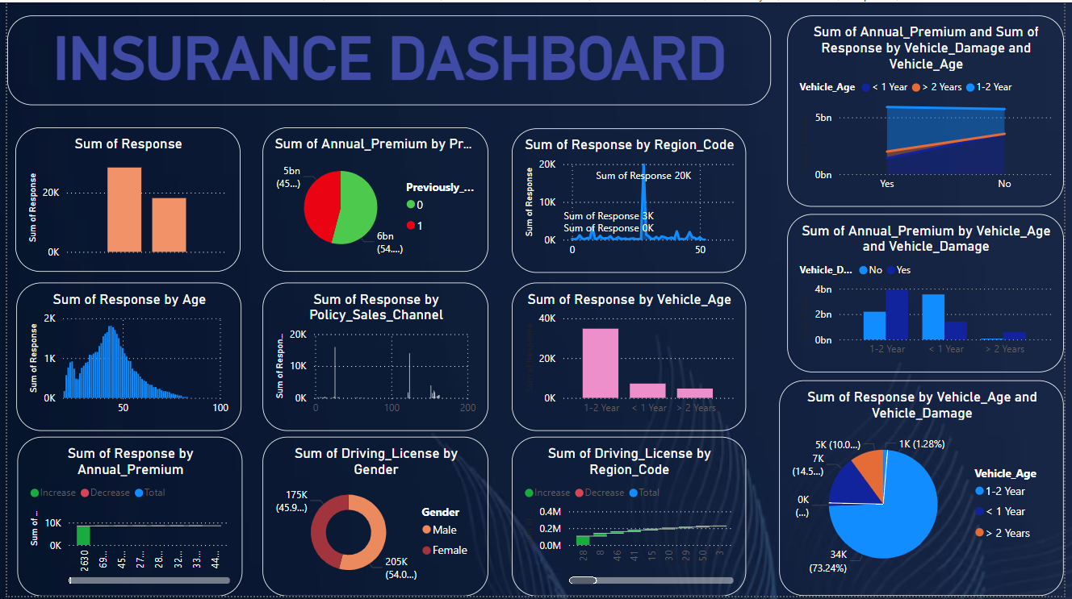
Dashboard

Slide 33
Conclusion
This project aims to revolutionize customer engagement and sales efficiency within the insurance industry. By harnessing the power of machine learning, we will develop a predictive model that accurately forecasts customer responses to insurance policy offers. This model will empower the organization with valuable customer insights, enabling the optimization of sales channels and the implementation of highly targeted marketing strategies. Ultimately, this project will drive increased conversion rates and improve the overall efficiency and profitability of the policy sales process.
Key takeaways:
This project leverages machine learning for predictive modeling.
The goal is to improve customer understanding and optimize sales strategies.
Expected outcomes include improved targeting, channel optimization, and higher conversion rates.

Slide 34
Thank You!

